Slide 1


Lecture 17:
Final Remarks
CoTaPP: Computational Thinking and
Programming with Python
All icons by: https://www.flaticon.com/

Slide 2

Today’s lecture
Summary of the course
Q&A
What is next?
Administrative aspects

Slide 3
Announcement
Selim’s Q&A: Monday, 11:00-12:45
(no Q&A on Tuesday, 9:15-11:00)

Slide 4
CoTaPP Recap

Slide 5
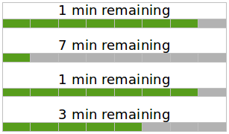
Lecture 1: Computational Thinking
How many minutes
will it take until all 4 ﬁles have ﬁnished downloading?

Slide 6
Lecture 1: Computational Thinking
After 1 min
6
2
How many minutes
will it take until all 4 ﬁles have ﬁnished downloading?

Slide 7
Lecture 1: Computational Thinking
After 1 min
3
6
1
2
How many minutes
will it take until all 4 ﬁles have ﬁnished downloading?

Slide 8
Lecture 1: Computational Thinking
After 1 min
After 2 min
3
6
2
3
1
2
1
How many minutes
will it take until all 4 ﬁles have ﬁnished downloading?

Slide 9
Lecture 1: Computational Thinking
After 1 min
After 2 min
3
6
1
2
3
1
2
1
How many minutes
will it take until all 4 ﬁles have ﬁnished downloading?

Slide 10
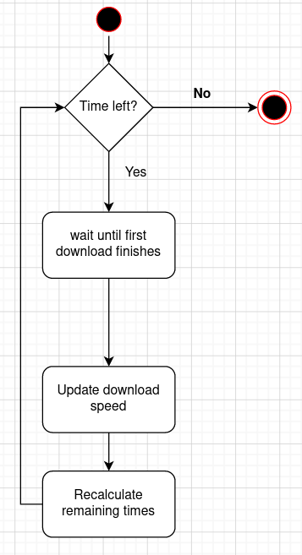

Lecture 2: Activity Diagrams

Slide 11
Lecture 3: Getting started with Python
print(‘1 min remaining’)

Slide 12
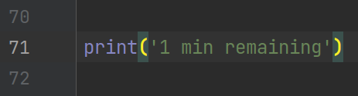
Lecture 3: Getting started with Python
print(‘1 min remaining’)

Slide 13


Lecture 3: Getting started with Python
print(‘1 min remaining’)

Slide 14
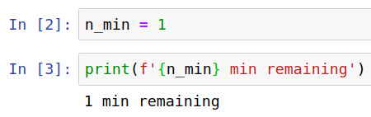
Lecture 3: Getting started with Python
print(‘1 min remaining’)

Slide 15

Lecture 3: Getting started with Python
print(‘1 min remaining’)

Slide 16
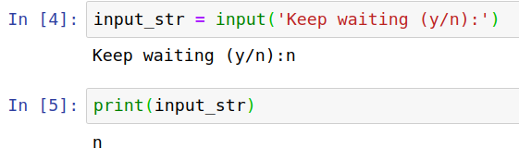
Lecture 3: Getting started with Python
print(‘1 min remaining’)

Slide 17
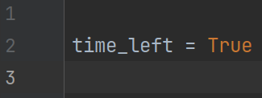
Lecture 4: Boolean expressions and conditional branching

Slide 18
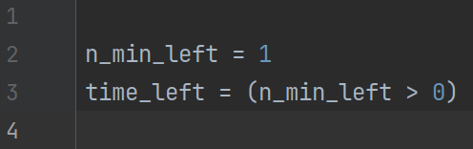
Lecture 4: Boolean expressions and conditional branching

Slide 19
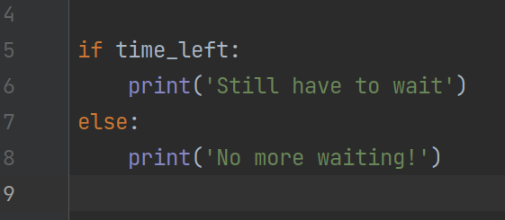
Lecture 4: Boolean expressions and conditional branching

Slide 20
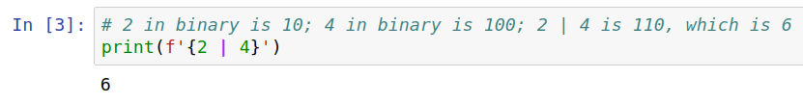
Lecture 4: Boolean expressions and conditional branching

Slide 21
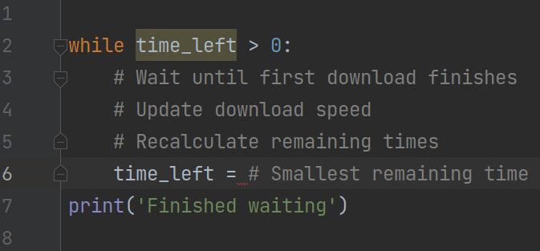
Lecture 5: Loops

Slide 22
Lecture 5: Loops
break
continue
for
Testing
Debugging

Slide 23
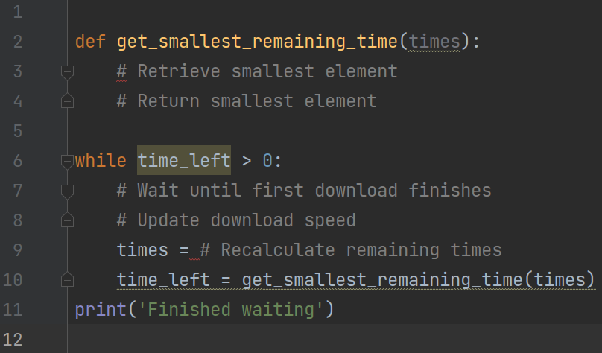
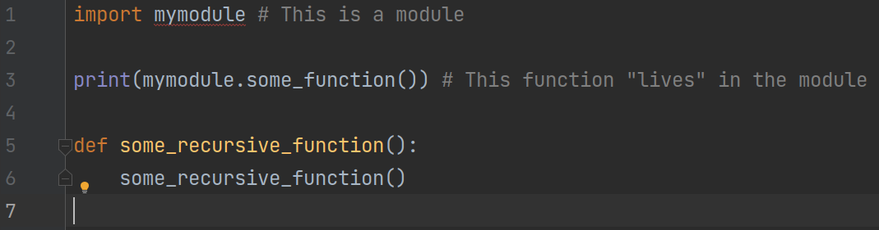
Lecture 6: Functions

Slide 24
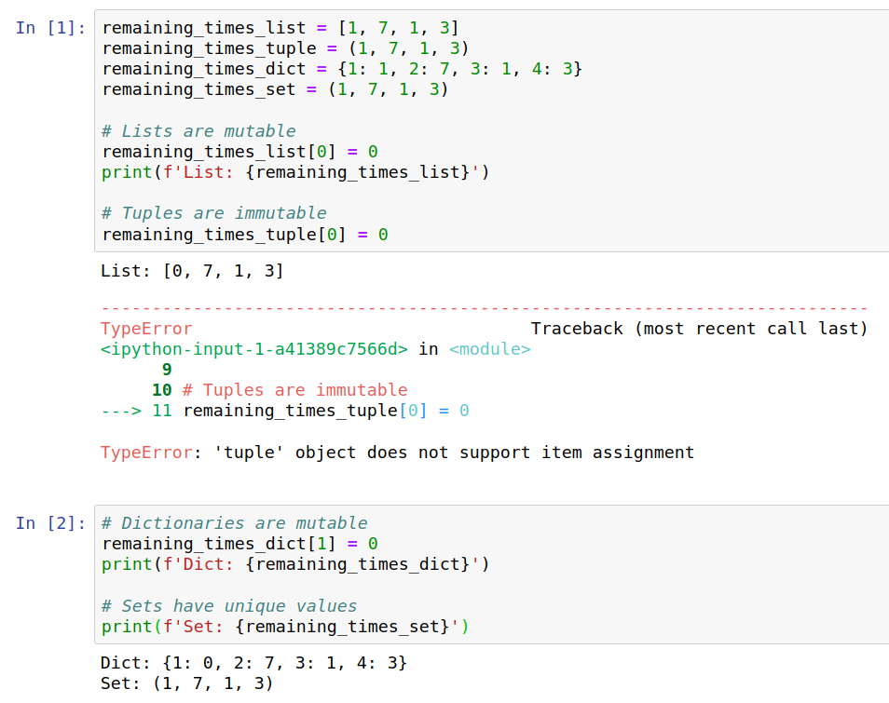
Lecture 7: Data Structures

Slide 25
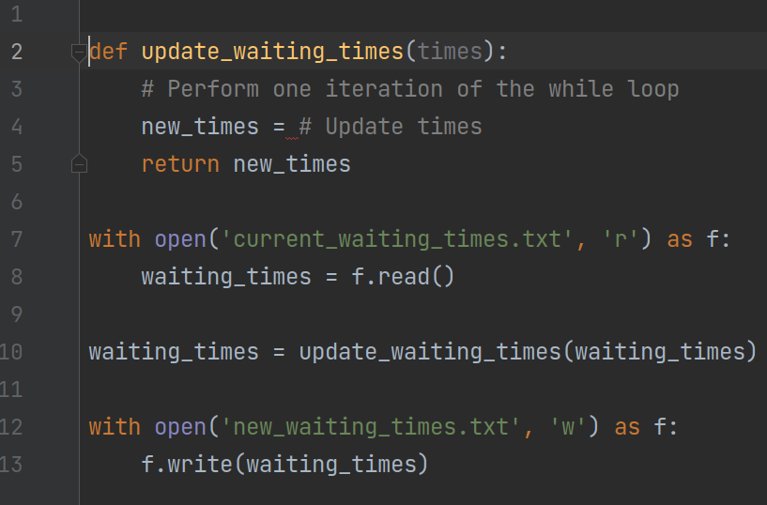
Lecture 8: File I/O

Slide 26
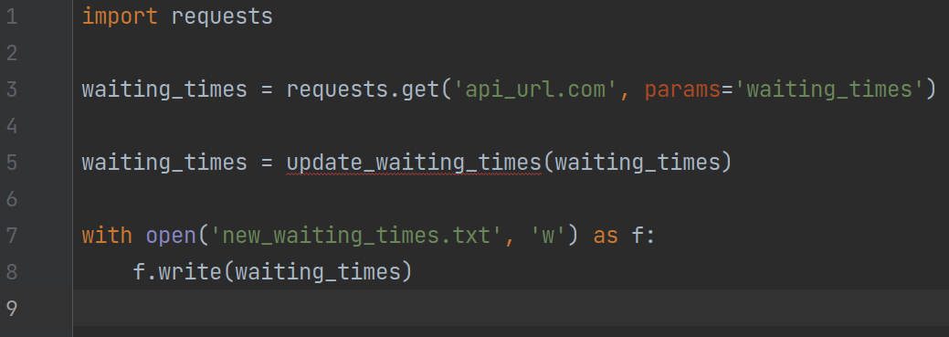
Lecture 9: Accessing Remote Resources

Slide 27
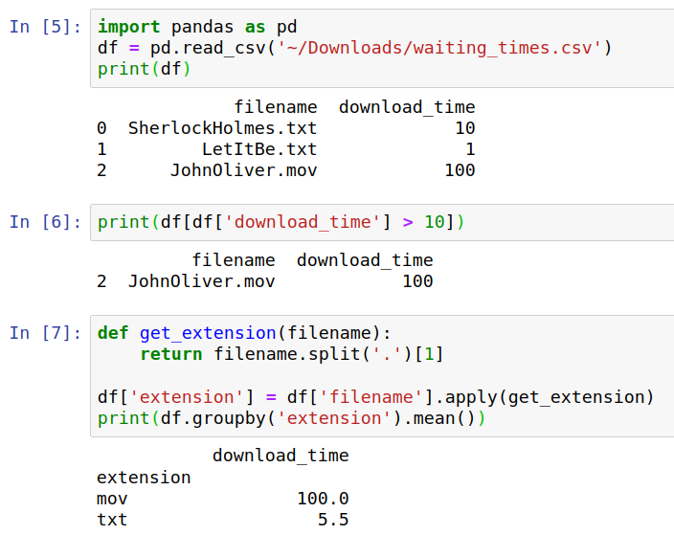
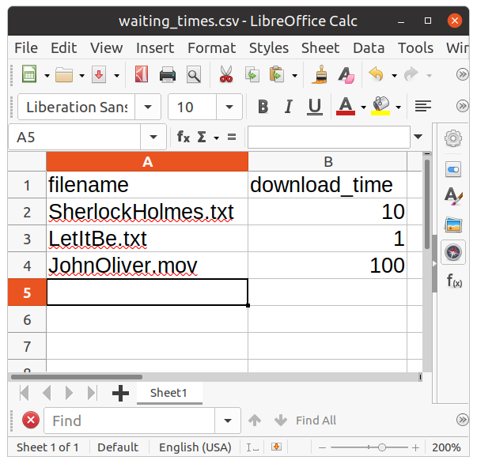
Lecture 10: Data Science

Slide 28
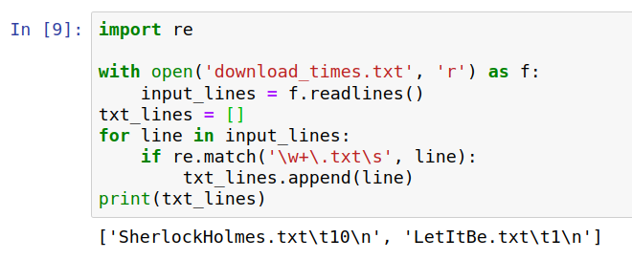

Lecture 11: Regular Expressions

Slide 29
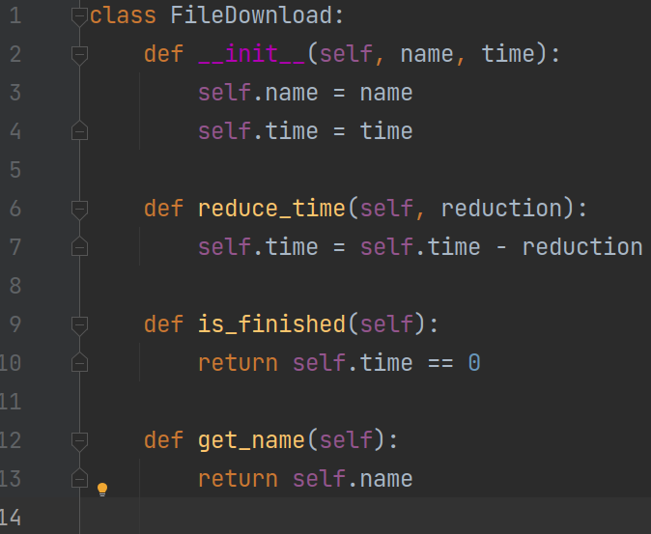
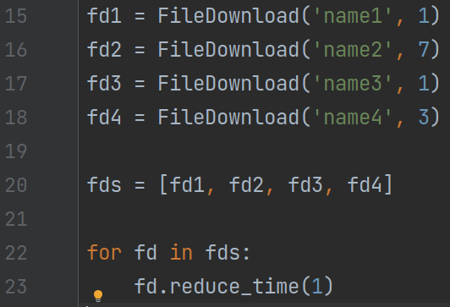
Lecture 12: OOP

Slide 30
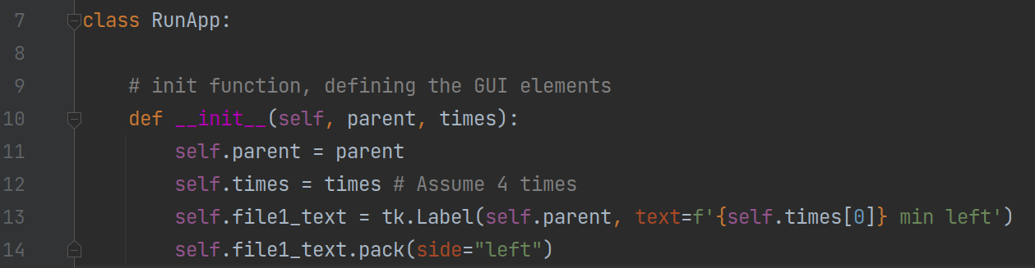
Lecture 13: Graphical Interfaces

Slide 31
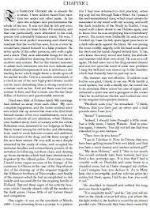



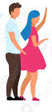



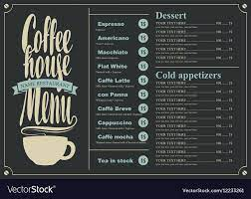
Lecture 14: Parallel Programming
Longest word
Most frequent word
Number of palindromes

Slide 32
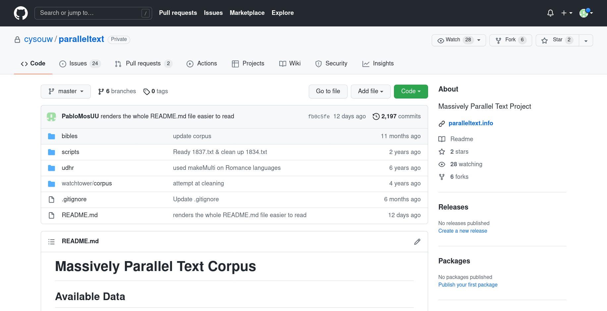
Lecture 15: Open Science

Slide 33
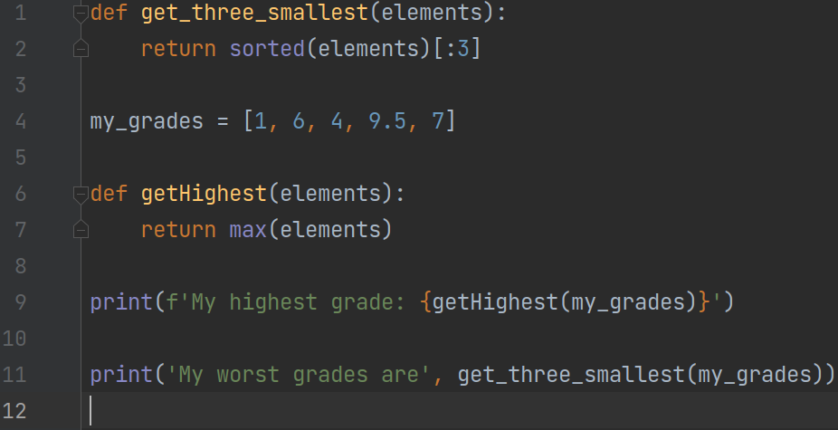
Lecture 16: Code Quality

Slide 34
Q&A

Slide 35
Life after CoTaPP

Slide 36
What is next?
You know how to program using Python
You know the basics of data science, open science, and write software for your research
But maybe, you want to keep learning more about those topics

Slide 37
Follow-up courses
There are no specific follow-up courses for this one
You can of course, follow other programming and software engineering courses from the computer science programs
  Not designed for "externals”

Slide 38
Follow-up courses
Research Data Management Support office (UU)
  Visit: https://www.uu.nl/en/research/research-data-management/training-workshops
  Different trainings:
    Best Practices for Writing Reproducible Code
    Introduction to R & Data

Slide 39
Follow-up courses
The Netherlands eScience Center
They offer (free) trainings on different (Python) programming courses
Visit: https://www.esciencecenter.nl/digital-skills/
Upcoming workshops:
  GPU Programming (high-performance computing)
  Parallel Programming in Python
  Data Carpentry for Social Sciences with Python (data skills needed to conduct research)

Slide 40
Follow-up courses
The dutch Research Software Engineering community
  Sign up to the NL-RSE mailing list
    https://nl-rse.org/pages/join
  Receive announcements of events organized by and for RSEs

Slide 41
Data Science Programs
Applied Data Science Master (UU)
  https://www.uu.nl/masters/en/applied-data-science
Data Science Master (University of Amsterdam)
  https://www.uva.nl/en/programmes/masters/information-studies-data-science/data-science.html?cb
Coursera or other online courses
  https://www.coursera.org/articles/what-is-a-data-scientist

Slide 42
More advanced Python
Databases
  https://realpython.com/tutorials/databases/
Network Programming
  https://www.geeksforgeeks.org/python-network-programming/
Web Development
  https://www.educative.io/blog/web-development-in-python
Machine Learning
  https://www.w3schools.com/python/python_ml_getting_started.asp

Slide 43
Open Source Development
The Linux Fundation
  (free) trainings
  Catalog: Open Source Best Practice
  Visit: https://training.linuxfoundation.org/full-catalog/?_sft_product_type=training&_sft_topic_area=open-source-best-practice
  Course: A Beginner’s Guide to Open Source Software Development

Slide 44
Intellectual Property
World Intellectual Property Organization
  DL-001 Primer on Intellectual Property
  DL-101 General Course on Intellectual Property
  Visit: https://welc.wipo.int/acc/index.jsf?page=courseCatalog.xhtml&lang=en

Slide 45
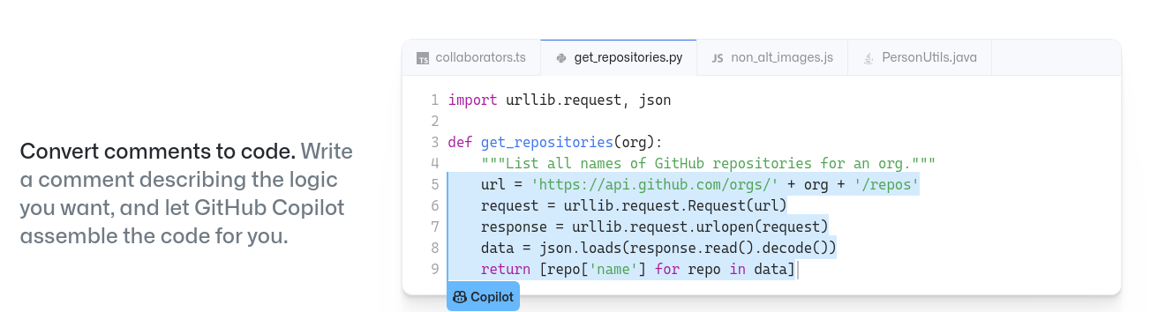
Future of Coding?
GitHub Copilot

Slide 46
Administrative

Slide 47
Course Evaluation
Course Evaluation in Caracal
  Open till 4/24/2022 11:00:00 PM
  Your comments help us to improve the course!
  Visit https://caracal.uu.nl/

Slide 48
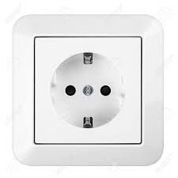
Final Exam
Final Exam
  Wednesday, April 13th, 2022, 17:00 – 20:00
  (+30 min for students qualifying for extra time)
  EDUC-THEATRON
  You will work on your own laptop
  Bb→CourseInformation→Final Exam Information
  Power outlets
  Missing final (sickness, force majeur)

Slide 49
Final Exam
The file assignment1_skeleton.py contains a main program for testing purposes (don’t change!) and a number of predefined but so far empty functions. Implement the functions as described in the following table:
Function function1(): returns the number of ….
Function function2(): returns a ….
Fucntion function3(): returns the total ...

Slide 50
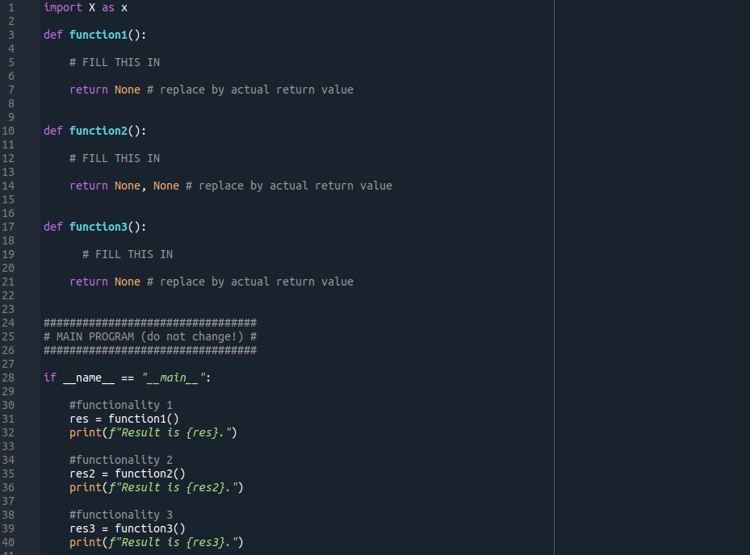

Slide 51
Other important dates
Project 4
  Deadline: 19th April, 13:00
Final grades
  ~ 03rd May
Retake
  06th July, 13:00
See Course Manual and MyTimetable

Slide 52
MasteryGrids Bonus
Use the platform
  Deadline: 13th April (before the exam)
After that:
  Give consent – An option will appear on MasteryGrids
  Fill in a short questionnaire (not required, but highly appreciated)
  After the exam, I will send an email to remind you about this

Slide 53


Slide 54


